Slide 1
WOMEN WELLNESS WEBAPP

Slide 2
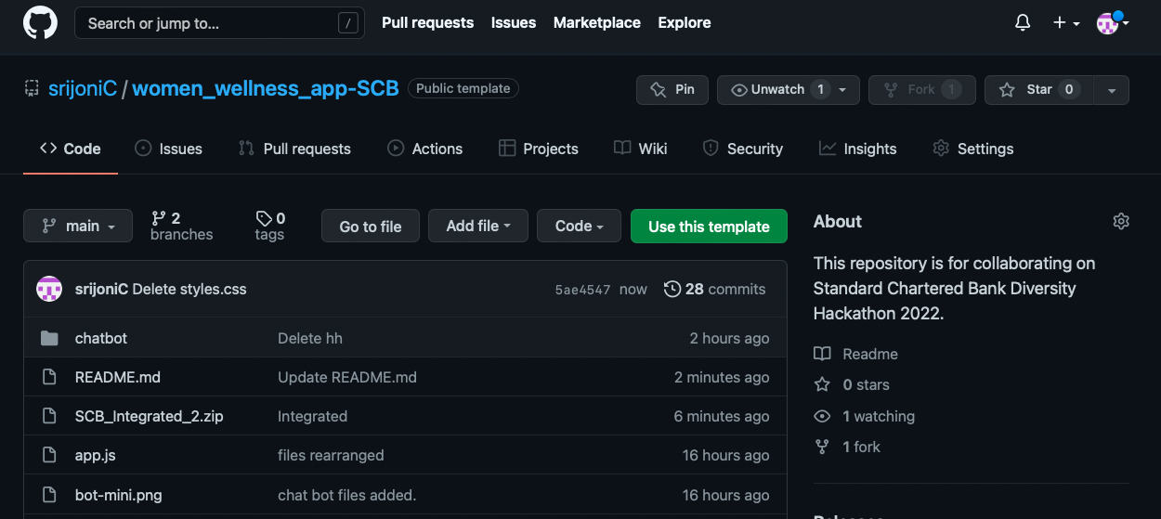
GITHUB REPO:-
https://github.com/srijoniC/women_wellness_app-SCB

Slide 3
TEAM MEMBERS:
Shikha Joshi shikhajoshi6027@gmail.com
Srijoni Chakraborty srijonichakraborty98@gmail.com
Sakshi Suman saks.15ee@gmail.com
Simran Singh simranssingh249@gmail.com
Sweta Shukla sweta9572000@gmail.com

Slide 4
EACH MEMBER CONTRIBUTION:
Srijoni Chakraborty : Firebase Authentication and Signup page, Static chatbot (Deployed), Self-evaluation form with score calculator, Card View of Common diseases.
Shikha Joshi: Backend with NodeJS and Mongodb + Integration of frontend and backend using javascript + Gathered Information
Sakshi Suman: Designed Frontend using CSS, HTML, JS-> Created Homepage + Dashboard + Created Login page and Explore page + Gathered Diseases Description
Sweta Shukla: Designed Frontend using CSS, HTML, JS -> Created Test Cards + Dashboard + Added Services, Disease Details, Explore page + Gathered Information

Slide 5
EACH MEMBER CONTRIBUTION:
Simran Singh: Designed and coded AI based chatbot using Python, machine learning (Decision Tree algorithm), performs diagnosis based on user symptoms and suggests home remedies

Slide 6
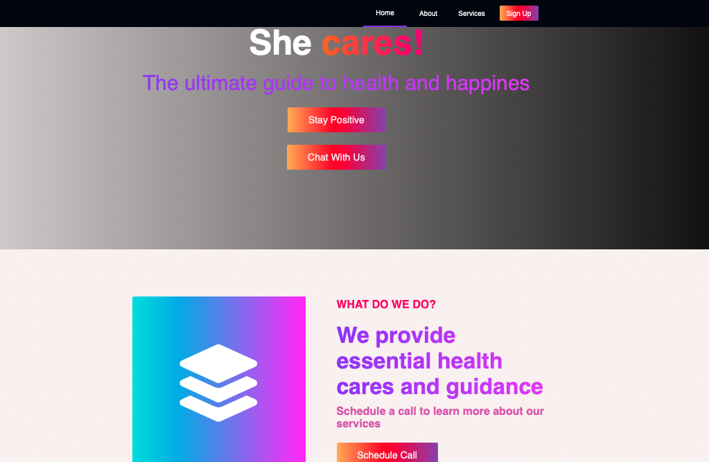
Home Page
Author : Sakshi Suman

Slide 7
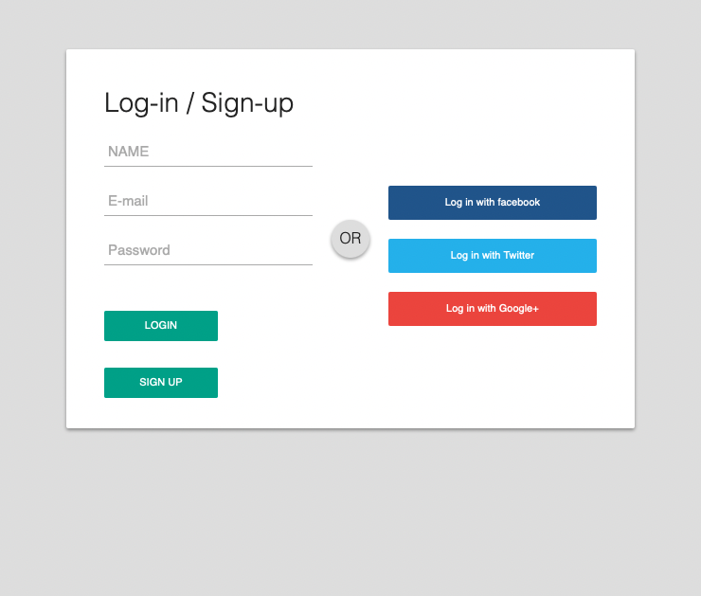
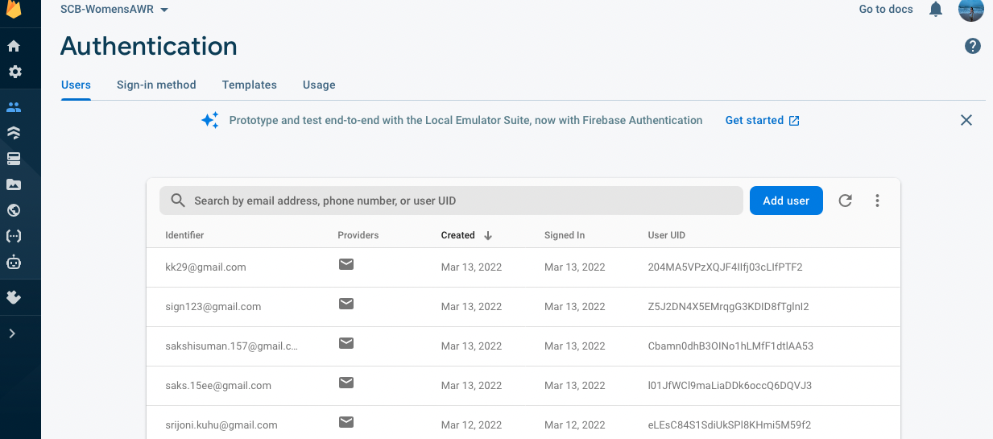
Login/SignUp Page
Srijoni Chakroborty

Slide 8
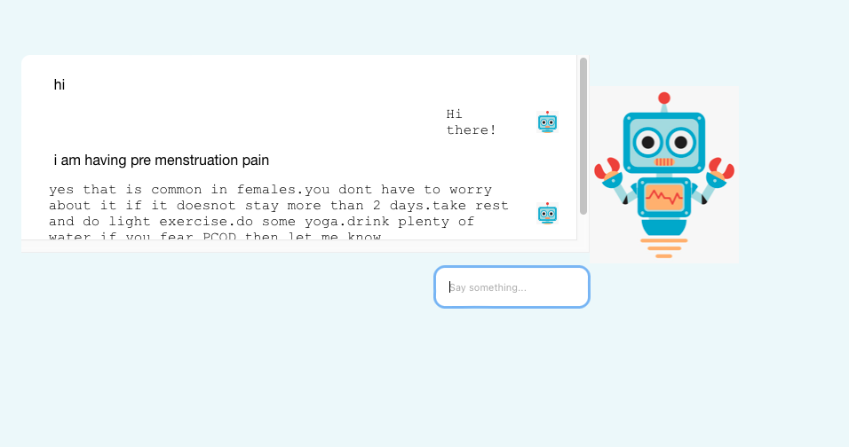
Chatbox
Srijoni Chakroborty

Slide 9
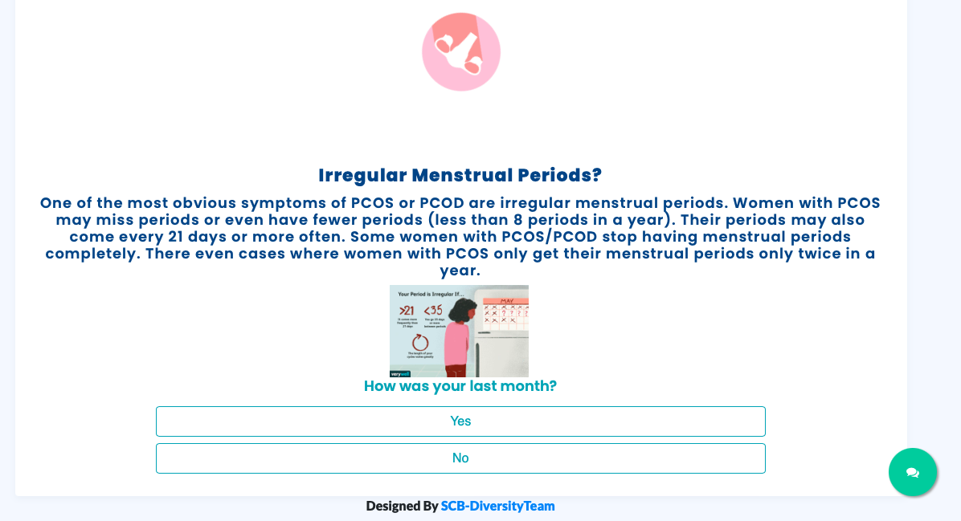
Self-Evaluation Forms
Srijoni Chakroborty

Slide 10
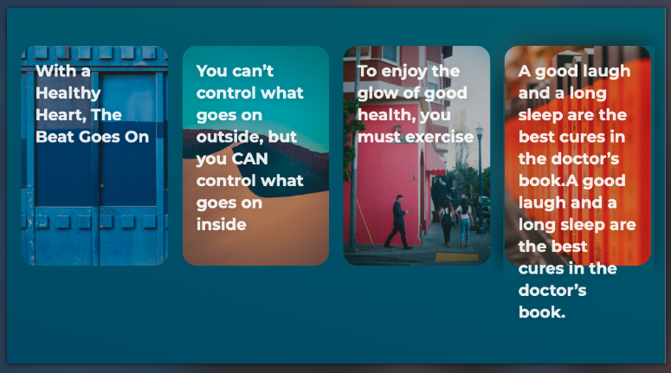
Card View Diseases
Srijoni Chakroborty

Slide 11
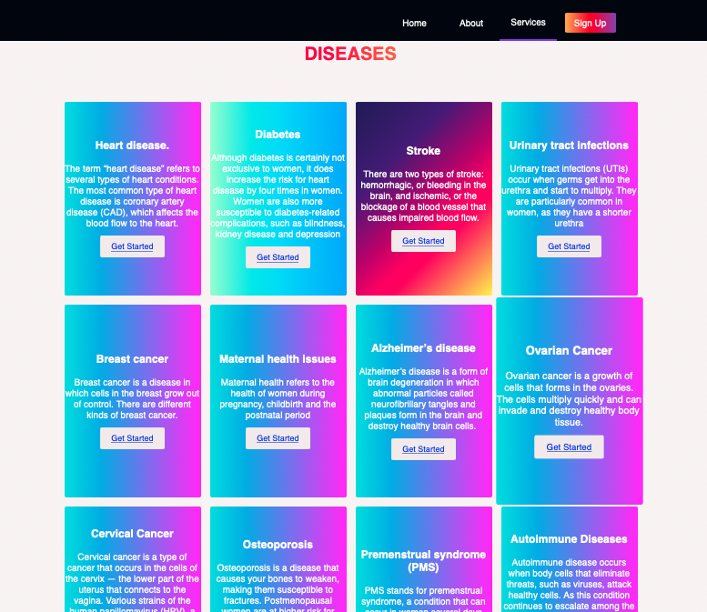
Sikha Joshi
Backend with NodeJS and Mongodb + Integration of frontend and backend using javascript + Gathered Information
CRUD operation APIs and MongoDB implementation for mass Information storage.
All the diseases and tests data are stored in the mongodb database.
Apis are implemented for all CRUD operations.
Requests are made to the apis from frontend so as to get the details of various diseases and various tests.
Diseases and Tests are displayed in the cards.
Detailed information of the diseases are also provided in the details page which includes its description,symptoms, cure and preventions based on the age group of the women.
For authentication of the user firebase is used.

Slide 12
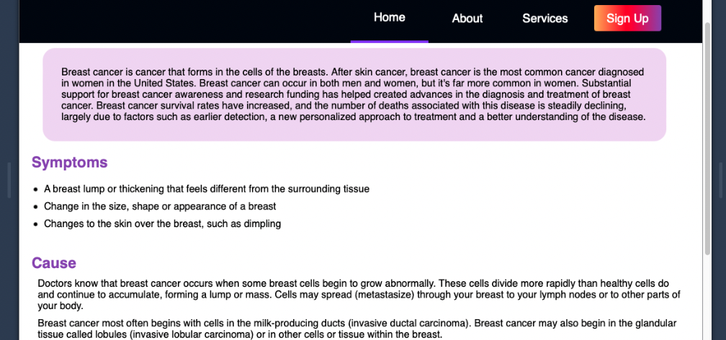
Sweta Shukla:
Created Test Cards + Dashboard + Added Services, Disease Details, Explore page + Gathered Information

Slide 13
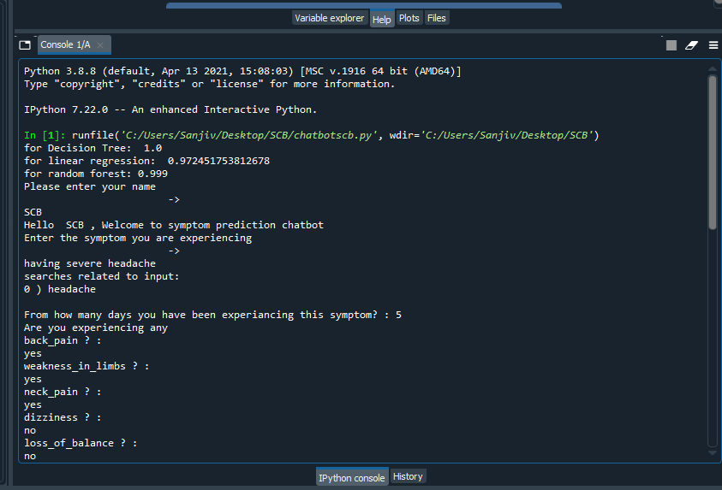
Future Scope ML Chatbot (by Simran Singh)
Integration of AI based chatbot, which will make the application more advanced
Tools considered for deployment are flask and other python libraries
Using NLP, many user inputs can be understood making the application more dynamic
Functions included are – collecting patient information, symptom severity, suggesting home remedies and disease description

Slide 14
THANKYOU

